Slide 1
Amazon Rekognition Deep Dive
Intelligent image and video analysis
Péter Molnár, February 2021

Slide 2
Agenda
Computer Vision
Amazon Rekognition
Use cases and Reference Architectures
Best Practices
Roadmap

Slide 3
Computer Vision

Slide 4














The AWS ML Stack Broadest and most complete set of Machine Learning capabilities
AI SERVICES
 | VISION | SPEECH | TEXT | SEARCH | CHATBOTS | PERSONALIZATION | FORECASTING | FRAUD | DEVELOPMENT | CONTACT CENTERS
Amazon Rekognition
Amazon Polly
Amazon Transcribe
+Medical
Amazon Comprehend
+Medical
Amazon Translate
Amazon Textract
Amazon Kendra
Amazon Lex
Amazon Personalize
Amazon Forecast
Amazon Fraud Detector
Amazon CodeGuru
Contact Lens
For Amazon Connect
ML SERVICES
Ground Truth | AWS Marketplace for ML |  |  |  |  |  |  |  |  |  | Neo | Augmented AI
 |  | Built-in algorithms | Notebooks | Experiments | Processing | Model training & tuning | Debugger | Autopilot | Model hosting | Model Monitor
SageMaker Studio IDE
Amazon SageMaker
ML FRAMEWORKS & INFRASTRUCTURE
Deep Learning AMIs & Containers | GPUs & CPUs | Elastic Inference | Inferentia | FPGA
DeepGraphLibrary
Notes:
Now, at the top of the stack, we serve developers and companies who want to add solution-oriented intelligence to their applications through an API call rather than developing and training their own models in SageMaker. And we have a lot of services in this area to do specific things like:
Vision (Rek Image and video) “tell me what’s in this image,” “which celebrities are in this image,” and, “is this image safe for work?”
Speech – (Polly, Transcribe) – If you want to turn text into speech we have Polly, and if you want to transcribe audio we have Transcribe
Text (translate, comprehend, textract) – If you want to translate text to different languages we have translate, and if you want to understand what’s being said in those translated corpuses of text you have Comprehend, if you want to extract text from documents using OCR++, you have Textract.
Then you have the things which Amazon is relatively famous for. Alexa and chatbots with Lex, personalization, and forecasting
Customers have asked us to continue to consider adding services around areas where we have a lot of experience and data from our consumer business…
Amazon Fraud Detector, a new fraud management service for detecting online identify and payment fraud in real-time. No machine learning experience required.
Amazon CodeGuru, a new machine learning service to automate code reviews and identify your most expensive line of code.
Contact Lens for Amazon Connect provides machine learning powered contact center analytics for Amazon Connect
Kendra, a new service which reinvents enterprise search with machine learning.

Slide 5
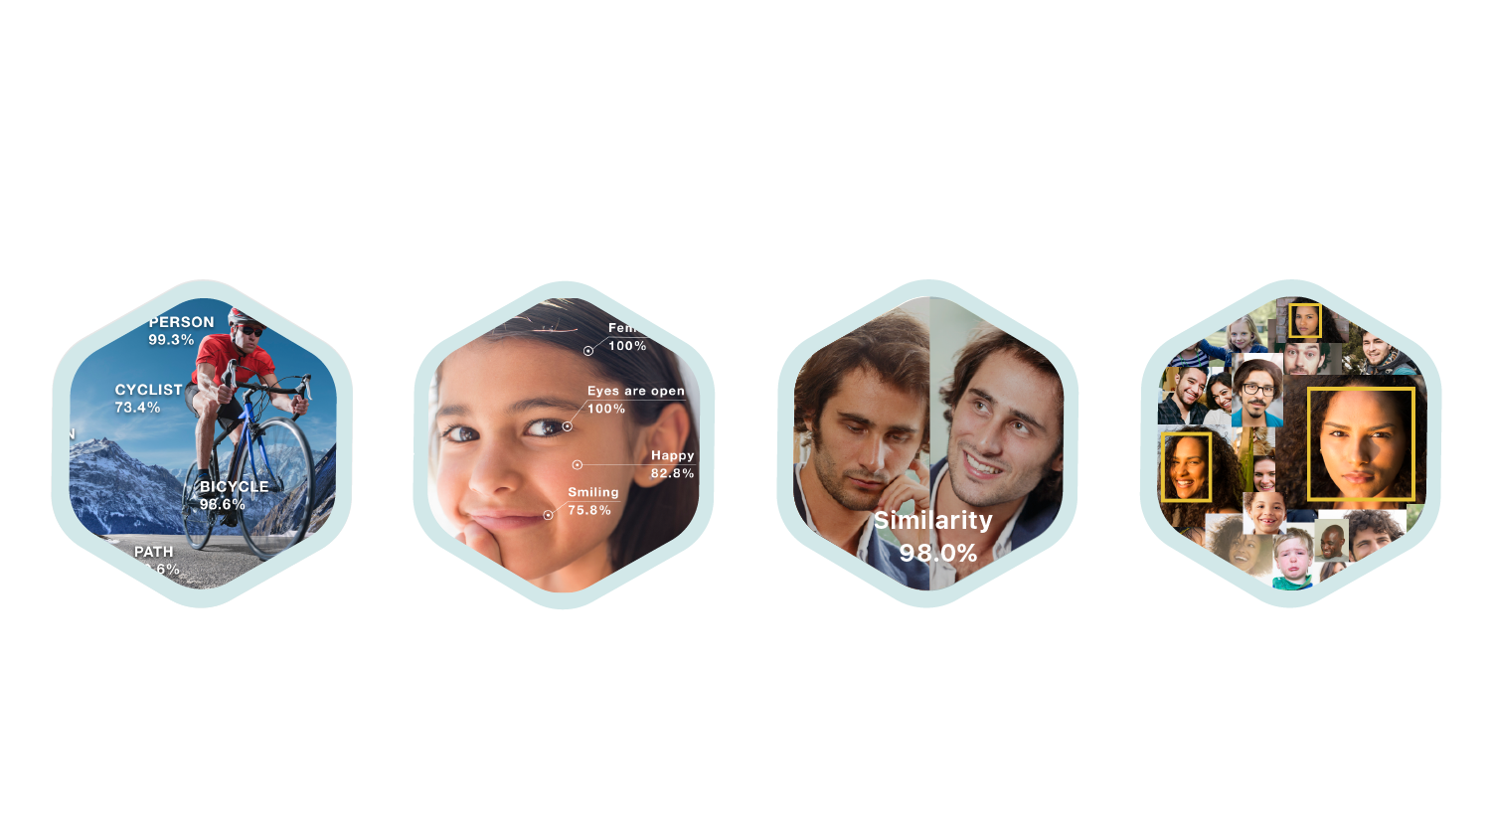



Amazon Rekognition
Extract rich metadata from visual content
Object, Scene and Activity Detection
Facial
Analysis
Face
Comparison
Facial
Recognition
Celebrity
Recognition
Unsafe Content Detection
Text In Images

Slide 6
Detecting Text
Detect and recognize text from images

Slide 7
Detecting Text – Image API
{
"Image": {
"Bytes": blob,
"S3Object": {
"Bucket": "string",
"Name": "string",
"Version": "string"
}
}
}
{
"TextDetections": [
{
"Confidence": number,
"DetectedText": "string",
"Geometry": {
"BoundingBox": {
"Height": number,
"Left": number,
"Top": number,
"Width": number
},
"Polygon": [
{
"X": number,
"Y": number
}
]
},
"Id": number,
"ParentId": number,
"Type": "string"
}
]
}
DetectText

Slide 8
Detecting Text Resources
Documentation
Image API
DetectText

Slide 9

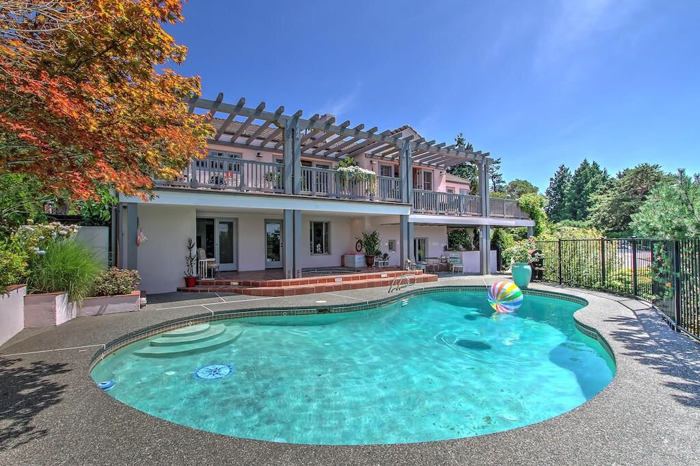
Object & Scene Detection
Identify objects and scenes with confidence scores
Living Room
Indoors
Backyard
Maple
Flower Arrangement
Cushion
Villa
Tree
Vase
Plant
Coffee Table
Potted Plant
Chair
Garden
Patio
Water
Swimming Pool
Furniture
Object and scene detection makes it easy for you to add features that search, filter, and curate large image libraries.
Notes:
- outcome, api, architecture, why

Slide 10

Object & Scene Detection – Image API
{
"Image": {
"Bytes": blob,
"S3Object": {
"Bucket": "string",
"Name": "string",
"Version": "string"
}
},
"MaxLabels": number,
"MinConfidence": number
}
{
"Labels": [
{
"Confidence": number,
"Name": "string”
}
],
"OrientationCorrection": "string"
}
DetectLabels

Slide 11
Object & Scene Detection – Video API
{
“ClientRequestToken": "string",
"JobTag": "string",
"MinConfidence": number,
"NotificationChannel": { "RoleArn": "string", "SNSTopicArn": "string”
},
"Video": {
"S3Object": {
"Bucket": "string",
"Name": "string", "Version": "string”
}
}
}
{
"JobStatus": string,
"StatusMessage": string,
"VideoMetadata": {
"Format": string,
"Codec": string,
"DurationMillis": number,
"FrameRate": float,
"FrameWidth": number,
"FrameHeight": number
},
"NextToken": string,
"Labels": [
{
"Timestamp": number,
"Label":
{
"Name": string,
"Confidence": float
}
}
],
...
StartLabelDetection
JobId
GetLabelDetection

Slide 12
Object & Scene Detection Resources
Documentation
Image API
DetectLabels
Video API
StartLabelDetection
GetLabelDetection

Slide 13
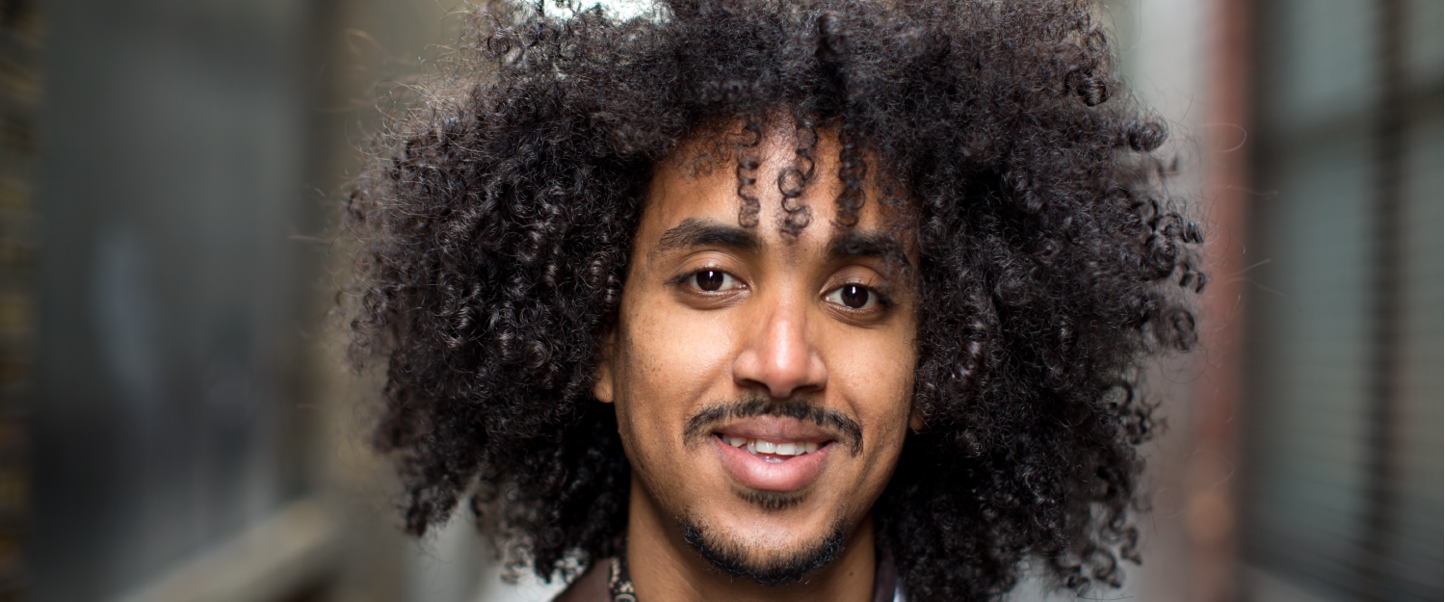
Facial Analysis
Analyze facial characteristics in multiple dimensions
Demographic Data
Emotion Expressed
Age Range 29-45
Gender:Male 96.5%
Happy 83.8%
Surprised 0.65%
Facial Landmarks
General Attributes
EyeLeft,EyeRight,Nose RightPupil,LeftPupil MouthRight,LeftEyeBrowUp
Bounding Box...
Smile:True 23.6%
EyesOpen:True 99.8%
Beard:True 99.5%
Mustache:True 99.9%...
Image Quality
Facial Pose
Brightness 23.6%
Sharpness 99.9%
Pitch 1.446
Roll 5.725
Yaw 4.383

Slide 14
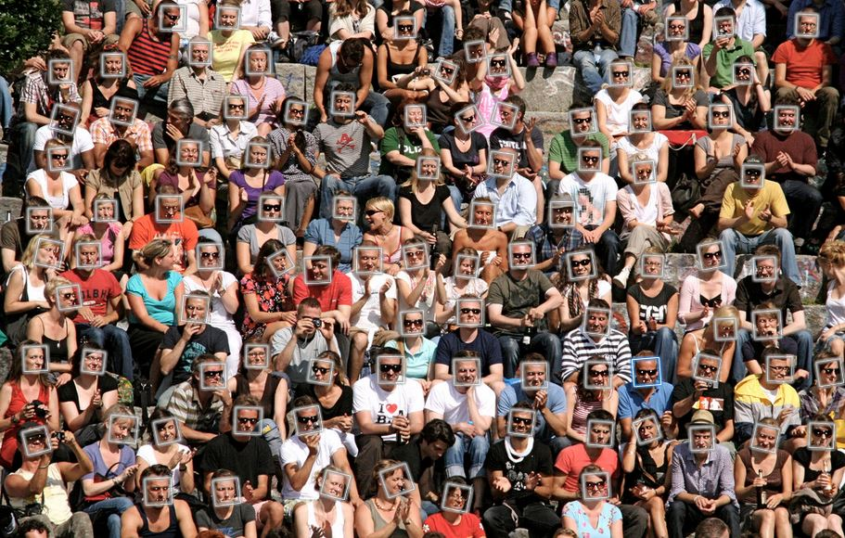
Facial Detection and Analysis - Crowd
Support for up to 100 faces
Notes:
We heard need from customers
Introducing Amazon Rekognition Video: a deep learning-based video recognition and analysis service for live or stored video that offers:
Object and Activity Detection: With Rekognition Video, you can detect thousands of objects and activities accurately, and extract motion-based context from a video. For example, your application can quickly analyze a consumer video of a baby's first walk, and generate labels like "baby”, "crawling”, "falling”, and "hugging” with timestamps and confidence scores. This allows you to generate search indexes for consumer video archives.
Person Tracking: With Rekognition Video motion-based video analysis capabilities, you can track people through the video even when their faces are not visible, or as the whole person might go in and out of the scene. This makes investigation and monitoring of individuals easy and accurate.
Face Recognition: Rekognition Video allows you to identify persons from a large existing collection of faces. This allows you to build applications that locate a Person of Interest in real time from a live stream or in batch from Amazon S3.
Streaming mode by native integration with Amazon Kinesis Video Streams: In streaming mode, the face detection and recognition APIs natively integrate with video stream from Kinesis Video Streams to provide output at low latency. Kinesis Video Streams enables developers to transmit thousands of live feeds and associated metadata to persist them on Amazon S3 and Glacier.
Content Moderation: Rekognition Video enables easy filtering of video for explicit and suggestive content, providing fine-grained detection of labels associated with inappropriate / NSFW content at a video frame level.
Celebrity Recognition: With Rekognition Video, you can detect and recognize celebrities in a video and track in which video frames each of them appears. This allows you to index and search digital video libraries for celebrities based on your particular interest.
Hawkeye summary:
Contextual insight - motion and real-time
Fully managed, scalable, and easy-to-use video analysis service
Deep learning-based -> Continuously improving
Integrated with Amazon S3, Amazon Kinesis Video Streams, AWS Lambda – get started with video analysis right out-of-the-box

Slide 15
Facial Analysis – Image API
{
"Image": {
"Bytes": blob,
"S3Object": {
"Bucket": "string",
"Name": "string",
"Version": "string"
}
}
}
{
"FaceDetails": [
{
"AgeRange": {
"High": number,
"Low": number
},
.
.
"BoundingBox": {
"Height": number,
"Left": number,
"Top": number,
"Width": number
},
"Confidence": number,
"Emotions": [
{
"Confidence": number,
"Type": "string"
}
],
.
.
.
"Gender": {
"Confidence": number,
"Value": "string"
},
"Landmarks": [
{
"Type": "string",
"X": number,
"Y": number
}
],
"Pose": {
"Pitch": number,
"Roll": number,
"Yaw": number
},
"Quality": {
"Brightness": number,
"Sharpness": number
},
.
.
.
}
],
"OrientationCorrection": "string"
}
DetectFaces

Slide 16
Facial Analysis - Video API
{
”Faces": [
{
“Face” : {
"AgeRange": {
"High": number,
"Low": number
},
.
.
.
"Gender": {
"Confidence": number,
"Value": "string"
}
},
“Timestamp” : number
}
]
"JobStatus": string,
"StatusMessage": string,
"VideoMetadata": {
"Format": string,
"Codec": string,
"DurationMillis": number,
"FrameRate": float,
"FrameWidth": number,
"FrameHeight": number
},
"NextToken": string,
}
{
“ClientRequestToken": "string",
"JobTag": "string",
”FaceAttributes": string,
"NotificationChannel": { "RoleArn": "string", "SNSTopicArn": "string”
},
"Video": {
"S3Object": {
"Bucket": "string",
"Name": "string", "Version": "string”
}
}
}
StartFaceDetection
JobId
GetFaceDetection

Slide 17
Facial Analysis Resources
Documentation
Image API
DetectFaces
Video API
StartFaceDetection
GetFaceDetection

Slide 18




Face Comparison
Measure the likelihood that faces are of the same person
Similarity 93%
Similarity 0%
Notes:
use the similarity score to verify a user against a reference photo in near real time

Slide 19
Face Comparison – API
{
"SimilarityThreshold": number,
"SourceImage": {
"Bytes": blob,
"S3Object": {
"Bucket": "string",
"Name": "string",
"Version": "string"
}
},
"TargetImage": {
"Bytes": blob,
"S3Object": {
"Bucket": "string",
"Name": "string",
"Version": "string"
}
}
}
{
"FaceMatches": [
{
"Face": {
"BoundingBox": {
...
},
"Confidence": number,
},
"Similarity": number
}
],
"SourceImageFace": {
"BoundingBox": {
...
},
"Confidence": number
},
"UnmatchedFaces": [
{
"BoundingBox": {
...
},
"Confidence": number,
}
]
.
.
.
}
CompareFaces
Notes:
Compares a face in the source input image with each of the 100 largest faces detected in the target input image.
If the source image contains multiple faces, the service detects the largest face and compares it with each face detected in the target image.
By default, only faces with a similarity score of greater than or equal to 80% are returned in the response. You can change this value by specifying theSimilarityThreshold parameter.

Slide 20
Face Comparison Resources
Documentation
Image API
CompareFaces

Slide 21
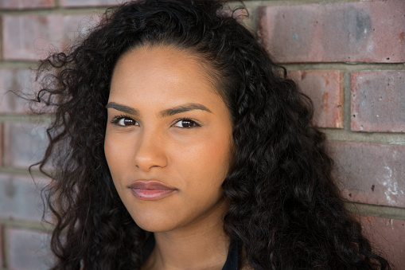
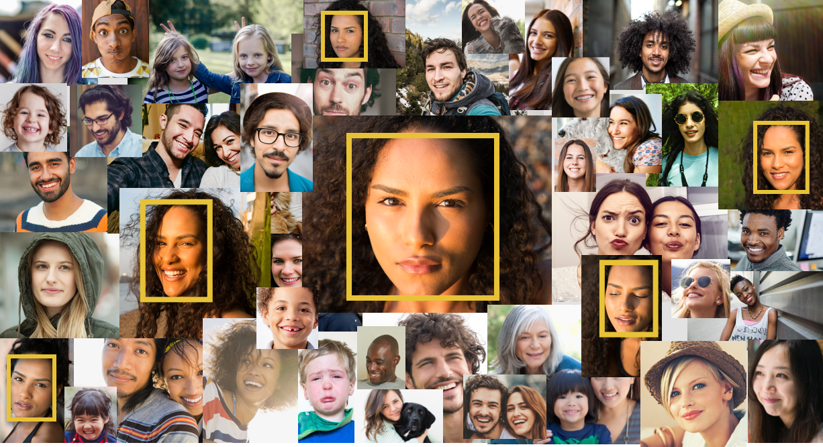
Facial Recognition
Identify a person in a photo or video using your private repository of face images
Index
Collection
Search
Notes:
use the similarity score to verify a user against a reference photo in near real time

Slide 22
Rekognition Collection
Amazon Rekognition can store information about detected faces in server-side containers known as collections.
Collection Management
CreateCollection
DeleteCollection
ListCollections

Slide 23
Adding Faces to a Collection
Index Faces
Detect 100 largest faces in the input image and add them to a collection
For each face detected, extracts facial features into a feature vector and stores in the database
ExternalImageId can be associated with all faces it detects
Notes:
Feature vector is used when performing face match and search

Slide 24
Facial Recognition – IndexFaces
{
"CollectionId": "string",
"DetectionAttributes": [ "string" ],
"ExternalImageId": "string",
"Image": {
"Bytes": blob,
"S3Object": {
"Bucket": "string",
"Name": "string",
"Version": "string"
}
}
}
{
"FaceModelVersion": "string",
"FaceRecords": [
{
"Face": {
"BoundingBox": {
...
},
"Confidence": number,
"ExternalImageId": "string",
"FaceId": "string",
"ImageId": "string"
},
"FaceDetail": {
"AgeRange": {
"High": number,
"Low": number
},
...
"Pose": {
"Pitch": number,
"Roll": number,
"Yaw": number
},
"Quality": {
"Brightness": number,
"Sharpness": number
},
}
}
],
"OrientationCorrection": "string"
}
IndexFaces
Notes:
Compares a face in the source input image with each of the 100 largest faces detected in the target input image.
If the source image contains multiple faces, the service detects the largest face and compares it with each face detected in the target image.
By default, only faces with a similarity score of greater than or equal to 80% are returned in the response. You can change this value by specifying theSimilarityThreshold parameter.

Slide 25
Facial Recognition – Image API
{
"CollectionId": "string",
"FaceMatchThreshold": number,
"Image": {
"Bytes": blob,
"S3Object": {
"Bucket": "string",
"Name": "string",
"Version": "string"
}
},
"MaxFaces": number
}
{
"FaceMatches": [
{
"Face": {
"BoundingBox": {
"Height": number,
"Left": number,
"Top": number,
"Width": number
},
"Confidence": number,
"ExternalImageId": "string",
"FaceId": "string",
"ImageId": "string"
},
"Similarity": number
}
],
"FaceModelVersion": "string",
"SearchedFaceBoundingBox": {
"Height": number,
"Left": number,
"Top": number,
"Width": number
},
"SearchedFaceConfidence": number
}
SearchFacesByImage
Notes:
For a given input image, first detects the largest face in the image, and then searches the specified collection for matching faces. The operation compares the features of the input face with faces in the specified collection.
- To search for all faces in an input image, you might first call the IndexFaces operation, and then use the face IDs returned in subsequent calls to the SearchFaces operation.
- You can also call the DetectFaces operation and use the bounding boxes in the response to make face crops, which then you can pass in to theSearchFacesByImage operation.
The response returns an array of faces that match, ordered by similarity score with the highest similarity first. More specifically, it is an array of metadata for each face match found. Along with the metadata, the response also includes a similarity indicating how similar the face is to the input face.

Slide 26
Facial Recognition - Video API
{
"JobStatus": "string",
"NextToken": "string",
"Persons": [
{
"FaceMatches": [
{
"Face": {
"BoundingBox": {
...
},
"Confidence": number,
"ExternalImageId": "string",
"FaceId": "string",
"ImageId": "string"
},
"Similarity": number
}
],
"Person": {
"BoundingBox": {
...
},
"Face": {
"AgeRange": {
"High": number,
"Low": number
},
"BoundingBox": {
...
},
"Confidence": number,
...
},
"Index": number
},
"Timestamp": number
}
],
"StatusMessage": "string",
"VideoMetadata": {
...
}
}
{
"ClientRequestToken": "string",
"CollectionId": "string",
"FaceMatchThreshold": number,
"JobTag": "string",
"NotificationChannel": {
"RoleArn": "string",
"SNSTopicArn": "string"
},
"Video": {
"S3Object": {
"Bucket": "string",
"Name": "string",
"Version": "string"
}
}
}
StartFaceSearch
JobId
GetFaceSearch

Slide 27
Facial Recognition – SearchFaces
{
"CollectionId": "string",
"FaceId": "string",
"FaceMatchThreshold": number,
"MaxFaces": number
}
{
"FaceMatches": [
{
"Face": {
"BoundingBox": {
"Height": number,
"Left": number,
"Top": number,
"Width": number
},
"Confidence": number,
"ExternalImageId": "string",
"FaceId": "string",
"ImageId": "string"
},
"Similarity": number
}
],
"FaceModelVersion": "string",
"SearchedFaceId": "string"
}
SearchFaces
Notes:
For a given input image, first detects the largest face in the image, and then searches the specified collection for matching faces. The operation compares the features of the input face with faces in the specified collection.
- To search for all faces in an input image, you might first call the IndexFaces operation, and then use the face IDs returned in subsequent calls to the SearchFaces operation.
- You can also call the DetectFaces operation and use the bounding boxes in the response to make face crops, which then you can pass in to theSearchFacesByImage operation.
The response returns an array of faces that match, ordered by similarity score with the highest similarity first. More specifically, it is an array of metadata for each face match found. Along with the metadata, the response also includes a similarity indicating how similar the face is to the input face.

Slide 28
Facial Recognition – ListFaces
{
"CollectionId": "string",
"MaxResults": number,
"NextToken": "string"
}
{
"FaceModelVersion": "string",
"Faces": [
{
"BoundingBox": {
"Height": number,
"Left": number,
"Top": number,
"Width": number
},
"Confidence": number,
"ExternalImageId": "string",
"FaceId": "string",
"ImageId": "string"
}
],
"NextToken": "string"
}
ListFaces
Notes:
For a given input image, first detects the largest face in the image, and then searches the specified collection for matching faces. The operation compares the features of the input face with faces in the specified collection.
- To search for all faces in an input image, you might first call the IndexFaces operation, and then use the face IDs returned in subsequent calls to the SearchFaces operation.
- You can also call the DetectFaces operation and use the bounding boxes in the response to make face crops, which then you can pass in to theSearchFacesByImage operation.
The response returns an array of faces that match, ordered by similarity score with the highest similarity first. More specifically, it is an array of metadata for each face match found. Along with the metadata, the response also includes a similarity indicating how similar the face is to the input face.

Slide 29
Facial Recognition Resources
Documentation
Collection Management
CreateCollection, DeleteCollection, ListCollections
Face Management
IndexFaces, ListFaces, Delete Faces
Search Face
SearchFaces
Image API: SearchFaceByImage
Video API: StartFaceSearch, GetFaceSearch

Slide 30
Unsafe Content Detection
Detect explicit and suggestive content
Notes:
Amazon Rekognition can determine if an image or video contains explicit or suggestive adult content.

Slide 31
Explicit and Suggestive Content Labels
Top-Level Category | Second-Level Category
Explicity Nudity | Nudity
 | Graphic Male Nudity
 | Graphic Female Nudity
 | Sexual Activity
 | Partial Nudity
Suggestive | Female Swimwear or Underwear
 | Male Swimwear of Underwear
 | Revealing Clothes
Notes:
Amazon Rekognition uses a hierarchical taxonomy to label categories of explicit and suggestive content. The two top-level categories are Explicit Nudity, and Suggestive. Each top-level category has a number of second-level categories.

Slide 32
Unsafe Content Detection – Image API
{
"Image": {
"Bytes": blob,
"S3Object": {
"Bucket": "string",
"Name": "string",
"Version": "string"
}
},
"MinConfidence": number
}
{
”ModerationLabels": [
{
"Confidence": number,
"Name": "string”,
“ParentName” : “string”
}
]
}
DetectModerationLabels
https://docs.aws.amazon.com/rekognition/latest/dg/API_DetectModerationLabels.html
Notes:
JPEG or PNG Images
Pass image as either base64-encoded image bytes or a reference to an image in S3

Slide 33
Unsafe Content Detection - Video API
{
“ClientRequestToken": "string",
"JobTag": "string",
"MinConfidence": number,
"NotificationChannel": { "RoleArn": "string", "SNSTopicArn": "string”
},
"Video": {
"S3Object": {
"Bucket": "string",
"Name": "string", "Version": "string”
}
}
}
{
"JobStatus": string,
"StatusMessage": string,
"VideoMetadata": {
"Format": string,
"Codec": string,
"DurationMillis": number,
"FrameRate": float,
"FrameWidth": number,
"FrameHeight": number
},
"NextToken": string,
”ModerationLabels": [
{
"Timestamp": number,
”ModerationLabel":
{
"Name": string,
"Confidence": float,
”ParentName” : string
}
}
],
...
StartContentModeration
JobId
GetContentModeration

Slide 34
Unsafe Content Detection Resources
Documentation
Image API
DetectModerationLabels
Video API
StartContentModeration
GetContentModeration
Amazon Rekognition
Use cases
Best Practices

Slide 35
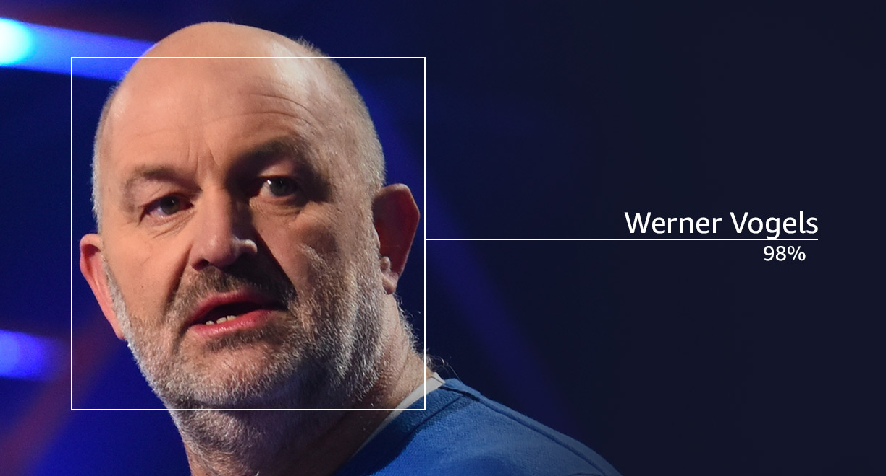
Celebrity Recognition
Recognize thousands of famous individuals

Slide 36
Celebrity Rcognition – Image API
{
"Image": {
"Bytes": blob,
"S3Object": {
"Bucket": "string",
"Name": "string",
"Version": "string"
}
}
}
{
"CelebrityFaces": [
{
"Face": {
"BoundingBox": {
...
},
"Confidence": number,
"Landmarks": [
{
...
}
],
"Pose": {
...
},
"Quality": {
...
}
},
"Id": "string",
"MatchConfidence": number,
"Name": "string",
"Urls": [ "string" ]
}
],
"OrientationCorrection": "string",
"UnrecognizedFaces": [
{
...
}
]
}
RecognizeCelebrities

Slide 37
Celebrity Rcognition – Video API
{
"Celebrities": [
{
"Celebrity": {
"BoundingBox": {
...
},
"Confidence": number,
"Face": {
"BoundingBox": {
...
},
"Confidence": number,
...
},
"Id": "string",
"Name": "string",
"Urls": [ "string" ]
},
"Timestamp": number
}
],
"JobStatus": "string",
"NextToken": "string",
"StatusMessage": "string",
"VideoMetadata": {
"Codec": "string",
"DurationMillis": number,
"Format": "string",
"FrameHeight": number,
"FrameRate": number,
"FrameWidth": number
}
}
{
“ClientRequestToken": "string",
"JobTag": "string",
"MinConfidence": number,
"NotificationChannel": { "RoleArn": "string", "SNSTopicArn": "string”
},
"Video": {
"S3Object": {
"Bucket": "string",
"Name": "string", "Version": "string”
}
}
}
StartCelebrityRecognition
JobId
GetCelebrityRecognition

Slide 38
Celebrity Recognition Resources
Documentation
Image API
RecognizeCelebrities
Video API
StartCelebrityRecognition
GetCelebrityRecognition
GetCelebrityInfo
Amazon Rekognition
Use cases
Best Practices

Slide 39
Pathing
Capture the path of people in the scene

Slide 40
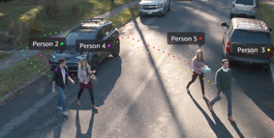
Pathing
"Persons": [
{
"Timestamp": number,
"Person":
{
"Index": number,
"BoundingBox":
{
"Width": number,
"Top": number,
"Height": number,
"Left": number
},
"Face":
{
"BoundingBox": { ... },
"Landmarks": { ... },
"Pose": { ... }, "Quality": { ... },
"Confidence": number
}
},
...
StartPersonTracking
GetPersonTracking

Slide 41
Pathing Resources
Documentation
API
StartPersonTracking
GetPersonTracking

Slide 42
Working with Streaming Video
CreateStreamProcessor
StartStreamProcessor
StopStreamProcessor
DescribeStreamProcessor
DeleteStreamProcessor
ListStreamProcessor

Slide 43
Use Cases

Slide 44


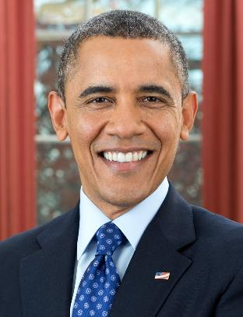

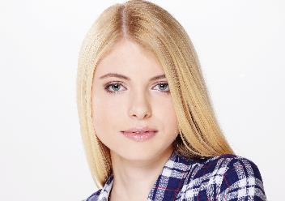
Validating or Indexing user-generated content
Age range – 26–43 years
Wearing glasses – 99.9%
Barrack Obama – 100%
Mouth open – 96%
Eyes closed – 94%
Eyes closed – 94%
Not smiling – 60.3%
Female – 100%
Notes:
Manual process for checking images – Labor intensive
Non-uniformity – Results vary from resource to resource
Scalability – Difficult to keep up with the rate of image generation

Slide 45








AWS solution
Step functions
9. Store metadata and analysis
Lambda
Amazon DynamoDB
2. Submit picture
Elasticsearch
3. Store live pic
Blacklist images
1. Live pic
4. DetectFaces
5.RecognizeCelebrities
7.DetectModerationLabels
8. SearchFaces
Blacklist
Whitelist
Duplicate check
Persons of interest
Amazon Rekognition
Amazon Rekognition
Amazon Rekognition
Amazon Rekognition
Notes:
Scalable solution – Pay as you go
Achieve greater levels of uniform policing
Improve security – Search against known blacklists
Add new features and improve customer experience
Finding best user picture from library

Slide 46
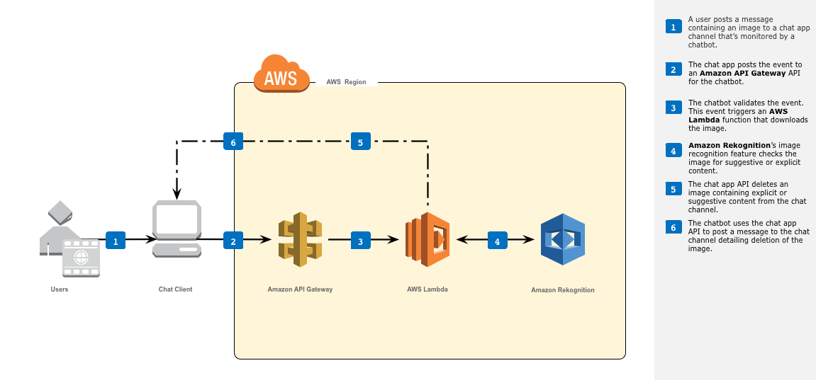
Chat moderation
https://github.com/aws-samples/lambda-refarch-image-moderation-chatbot

Slide 47
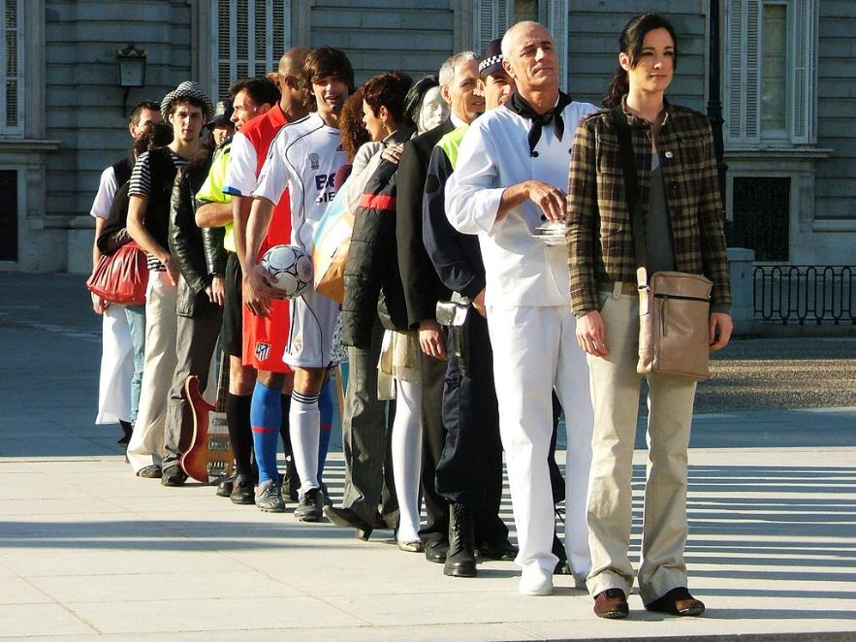
Optimize check-in / check-out process
Face matched - 97%
New customer
Face matched - 94%
Face matched - 99%
VIP customer
Notes:
Slow and lengthy
Error prone – Depends on traditional inspection methods
Security risk – Relatively easy to circumvent
Manual labor intensive – Staffing challenges

Slide 48


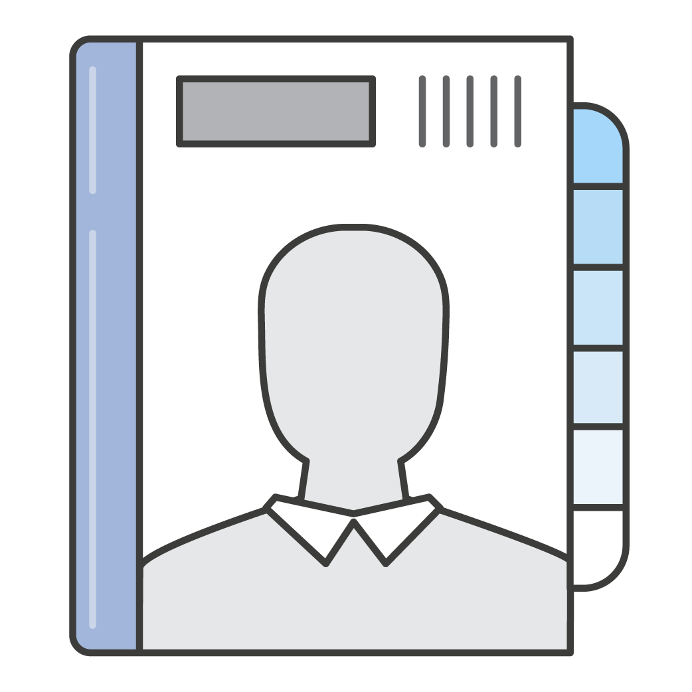
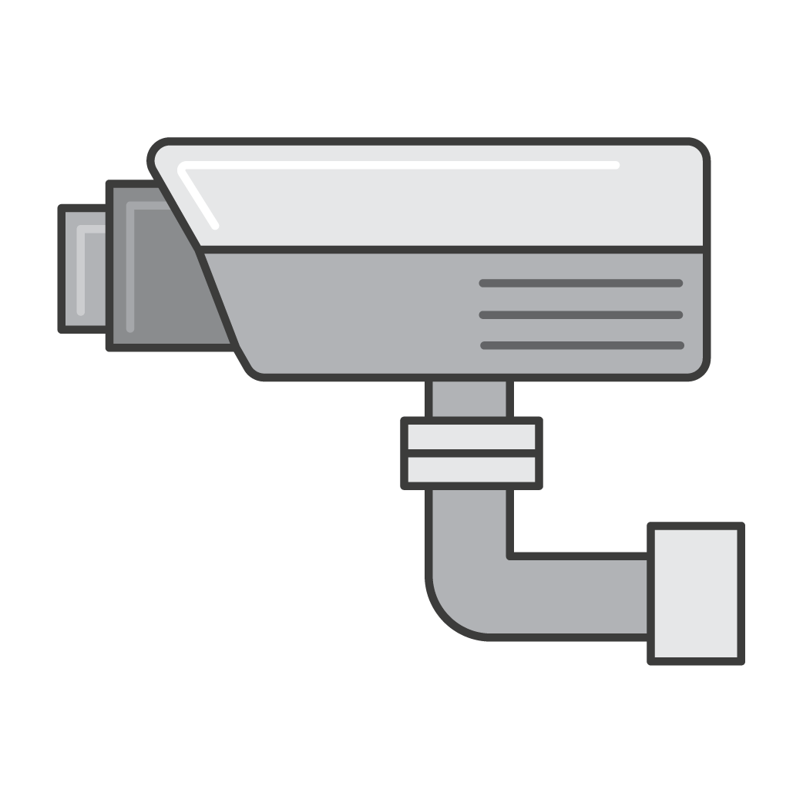

AWS solution
Secure verification source
1a. Scan ID
4. Verify ID
5. Return reference picture
2. Submit details
Lambda
API Gateway
8. Store Metadata and final decision
Amazon DynamoDB
1b. Live pic
3. Store live pic
6a. IndexFaces
ExternalImageID
7. CompareFaces
6b. FaceId
Amazon Rekognition
Amazon Rekognition
Notes:
Faster streamlined process – Decrease wait times
Don’t compromise security
Ability to check against a known blacklist using the SearchFaces API
Automate check-in / check-out process – curb proxies
Add more value – Re-use your resources effectively
Custom service – Provide VIP service to repeat customers

Slide 49

Live demographic analysis
Female: 100%
Happy: 99.9%
Age Range: 11–18
Male: 99.7%
Happy: 97.9%
Age Range: 26–43
Female: 100%
Happy: 99.6%
Age Range: 27–44
Notes:
Paper / online forms -> resource intensive
Low fulfillment rate -> imperfect data
Lengthy execution-to-results workflow

Slide 50
Real-time store heat map
Section A
Section B
Section C
8–19 years
20–35 years
Male
Section D
Section E
Female
Section F
Section G
Time

Slide 51


AWS solution
Amazon DynamoDB
2. Submit picture
Lambda
6. Store metadata and analysis
Amazon QuickSight
API Gateway
1. Live pic
Amazon Redshift
3. Store live pic
5. SearchFaces -Blacklist
4. DetectFaces
Amazon Rekognition
Amazon Rekognition
Notes:
Achieve near 100% coverage – Use strategic camera placement
Improve Security – Search against known blacklists
Unlock new behavioral patterns – Co-relate demographic data with other data
Near real-time analysis – Respond immediately, based on current demographics

Slide 52
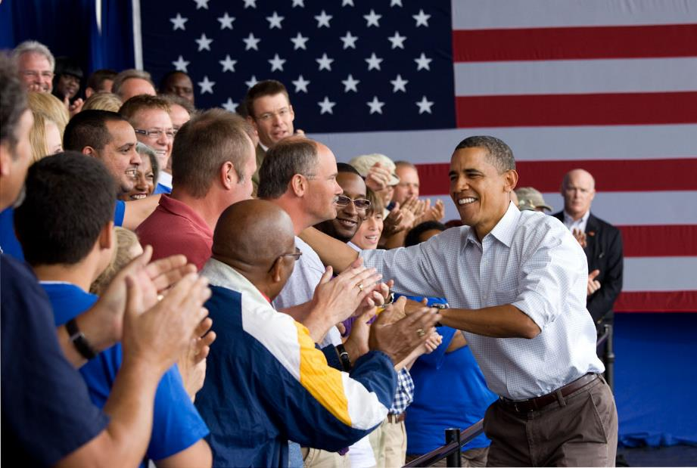
Person(s) of interest
Hypothetical person of interest – 86%
CelebrityDetected – 95%

Slide 53


Solution
DetectModerationLabels
3
DetectLabels
IndexFaces
SearchFacesByImage
{
"FaceMatches": [
{"Face": {"BoundingB
"Height": 0.2683333456516266,
"Left": 0.5099999904632568,
"Top
1
{
"FaceMatches": [
{"Face": {"BoundingB
"Height": 0.2683333456516266,
"Left": 0.5099999904632568,
"Top": 0.1783333271741867,
"Width": 0.17888888716697693},
"
SearchFaces
CreateCollection
CompareFaces
ListCollections
DeleteCollection
2
ListFaces
DetectFaces
RecognizeCelebrities
DeleteFaces
GetCelebrityInfo
aws rekognition create-collection --collection-id “persons-of-interest”
aws rekognition index-faces --image “S3Object={Bucket=mybucket,Name=subject.jpg}” \
--collection-id “persons-of-interest”
aws rekognition recognize-celebrities –image “S3Object={Bucket=mybucket,Name=cam.jpg}”
aws rekognition search-faces-by-image –image “S3Object={Bucket=mybucket,Name=cam.jpg}” \
--collection-id “persons-of-interest"

Slide 54
Other use cases
People counting: Eye-level cameras capture people entering and exiting a place. Amazon Rekognition can then be used to keep a live count of people inside the place at any given time.
Suspicious object left behind: Amazon Rekognition receives an image of each person, which is used to associate individuals with suspicious objects (e.g., backpacks). Each time a new face is matched, the application compares the metadata for that individual and issues an alert when the suspicious objects are no longer detected.

Slide 55
Customer Stories

Slide 56

WA County Sheriff’s Office
300,000+ images of previous offenders indexed in 2 days
Match time reduced from multiple days to seconds
First suspect apprehended within a week
Notes:
We heard need from customers
Introducing Amazon Rekognition Video: a deep learning-based video recognition and analysis service for live or stored video that offers:
Object and Activity Detection: With Rekognition Video, you can detect thousands of objects and activities accurately, and extract motion-based context from a video. For example, your application can quickly analyze a consumer video of a baby's first walk, and generate labels like "baby”, "crawling”, "falling”, and "hugging” with timestamps and confidence scores. This allows you to generate search indexes for consumer video archives.
Person Tracking: With Rekognition Video motion-based video analysis capabilities, you can track people through the video even when their faces are not visible, or as the whole person might go in and out of the scene. This makes investigation and monitoring of individuals easy and accurate.
Face Recognition: Rekognition Video allows you to identify persons from a large existing collection of faces. This allows you to build applications that locate a Person of Interest in real time from a live stream or in batch from Amazon S3.
Streaming mode by native integration with Amazon Kinesis Video Streams: In streaming mode, the face detection and recognition APIs natively integrate with video stream from Kinesis Video Streams to provide output at low latency. Kinesis Video Streams enables developers to transmit thousands of live feeds and associated metadata to persist them on Amazon S3 and Glacier.
Content Moderation: Rekognition Video enables easy filtering of video for explicit and suggestive content, providing fine-grained detection of labels associated with inappropriate / NSFW content at a video frame level.
Celebrity Recognition: With Rekognition Video, you can detect and recognize celebrities in a video and track in which video frames each of them appears. This allows you to index and search digital video libraries for celebrities based on your particular interest.
Hawkeye summary:
Contextual insight - motion and real-time
Fully managed, scalable, and easy-to-use video analysis service
Deep learning-based -> Continuously improving
Integrated with Amazon S3, Amazon Kinesis Video Streams, AWS Lambda – get started with video analysis right out-of-the-box

Slide 57
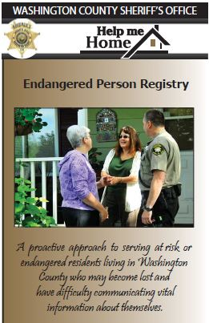
Help Me Home Project
Proactive approach to serve at risk or endangered residents
Voluntary enrollment
Fast access to caregivers
Support for adults and children
may become lost and have difficulty communicating vital information about themselves

Slide 58



Combatting Human Trafficking on AWS
ML supporting law enforcement and victim rescue
Machine learning and analytics platforms for law enforcement
Match photos of exploited children to those on the dark web
Reduces the time and effort to identify and rescue victims

Slide 59
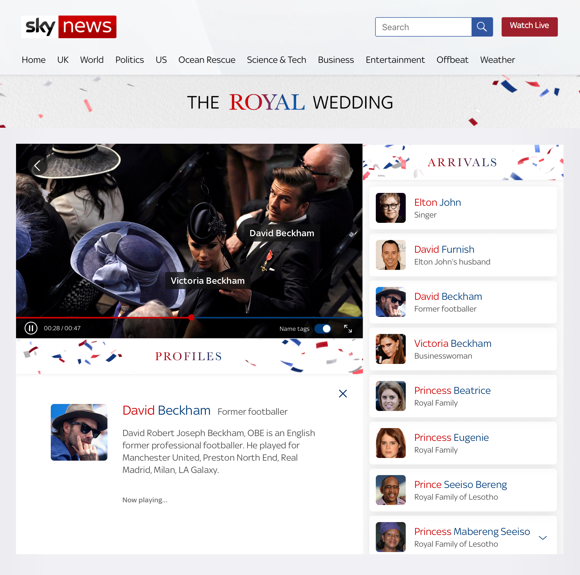
Celebrity Guests at the Royal Wedding
“Who’s Who Live” function
Celebrity guests identified in live stream
On Screen captions of relation to the royal couple
Notes:
Amazon helped viewers of this weekend’s royal wedding identify celebrity guests using artificial intelligence (AI).
Those watching the wedding via U.K. broadcaster Sky News’ livestream were able to use a “Who’s Who Live” function, a collaboration between Sky News, Amazon Web Services and AWS partners GrayMeta and UI Centric.
As guests arrived at St. George’s Chapel at Windsor Castle, the function identified royals and other notable guests through on-screen captions, interesting information about each celebrity and how they are connected to Prince Harry and Meghan Markle.
The function was made possible by Amazon Rekognition, a cloud-based technology that uses AI to recognize and analyze faces, as well as objects, scenes and activities in images and video. And Sky News isn’t the first to use it: C-SPAN utilizes Rekognition to tag people speaking on camera.

Slide 60
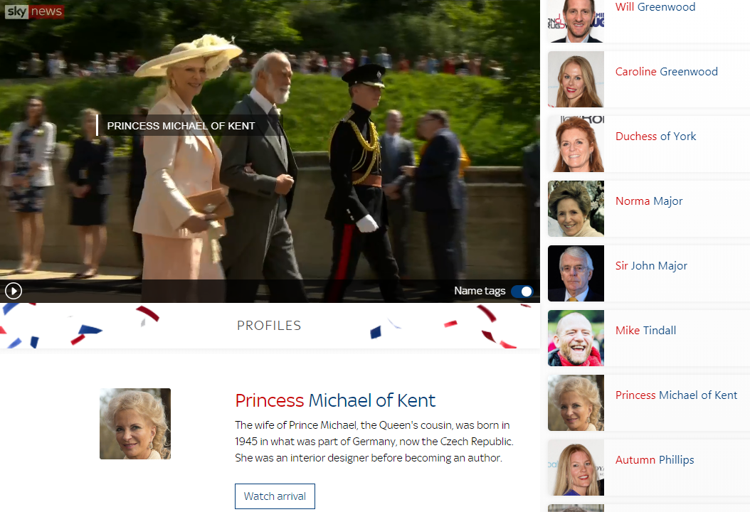

Slide 61
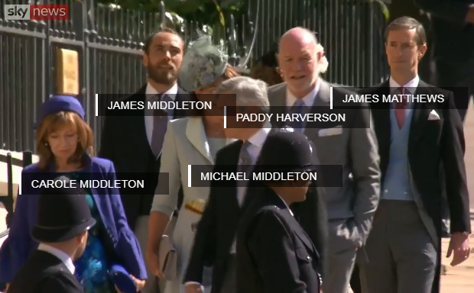

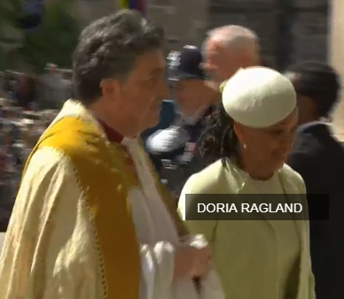
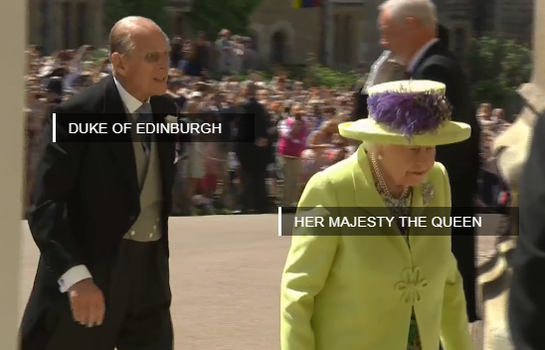
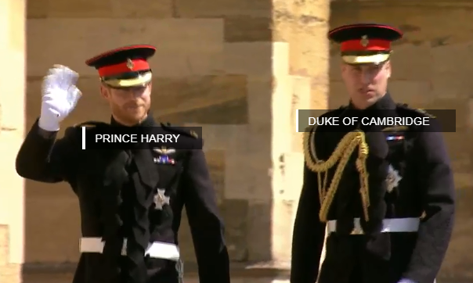

Slide 62
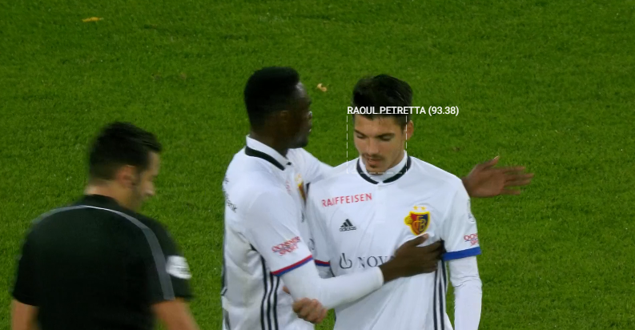
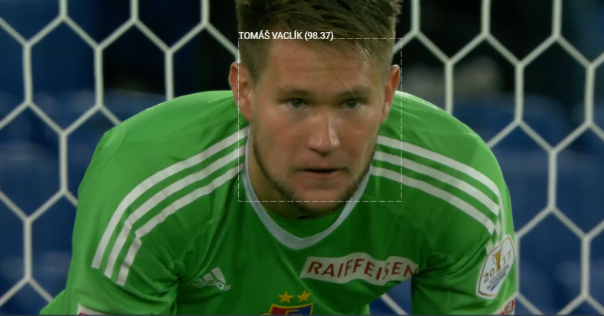
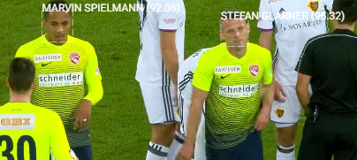
Sports Media: Player Tracking and Recognition

Slide 63
FUTURE: Detect DUI (10K/yr die/yr/US)
&
FUTURE: Falling Asleep (7K/yr mortality rate US)

Slide 64
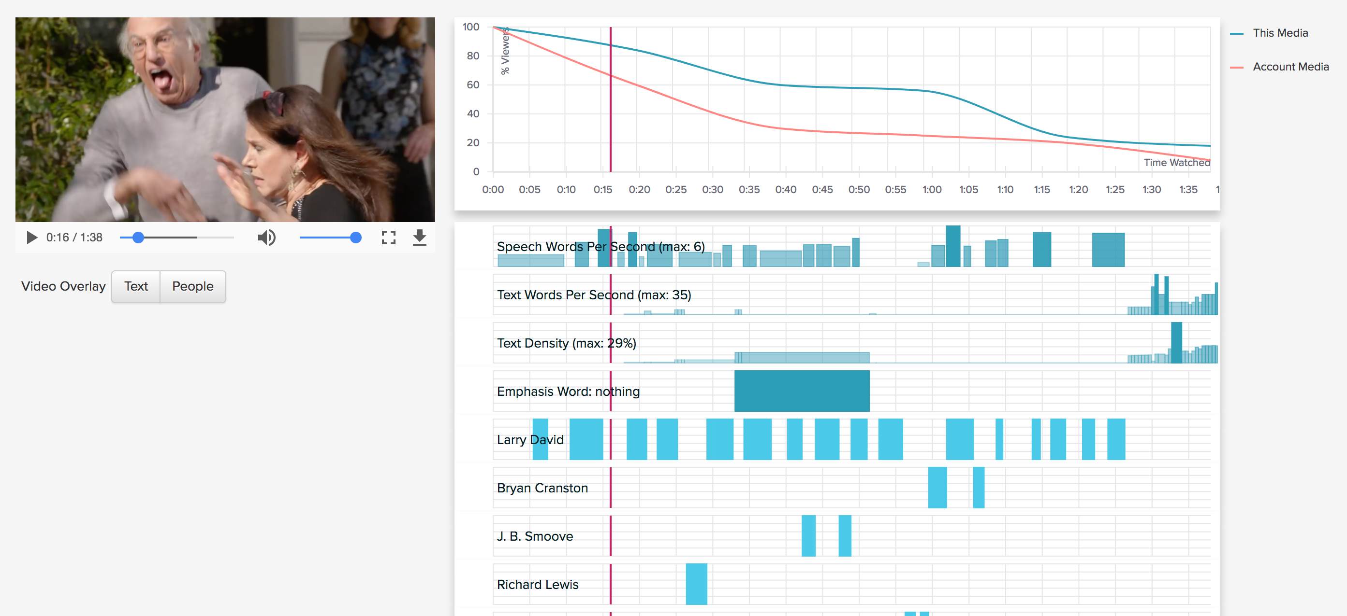
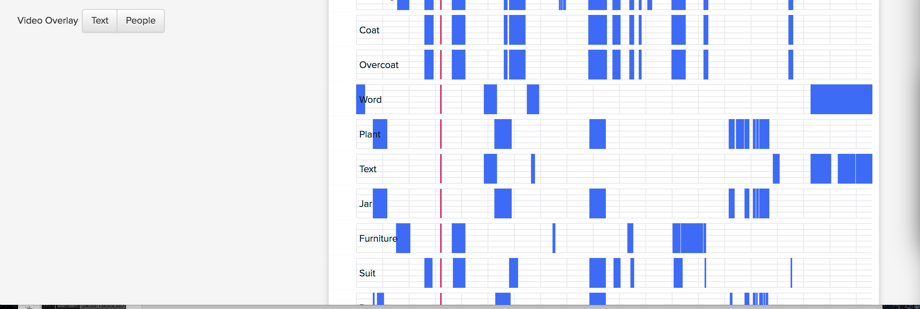
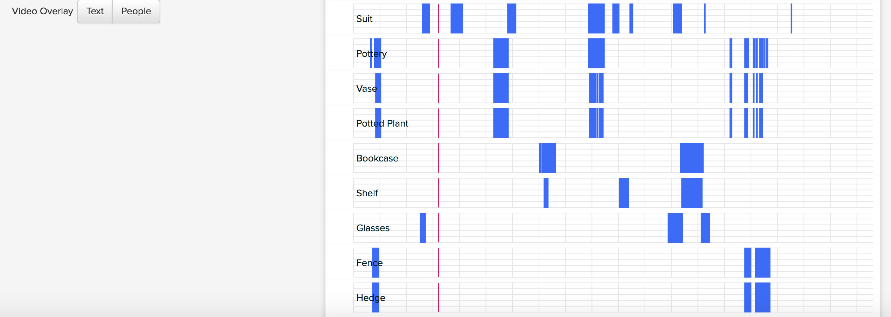
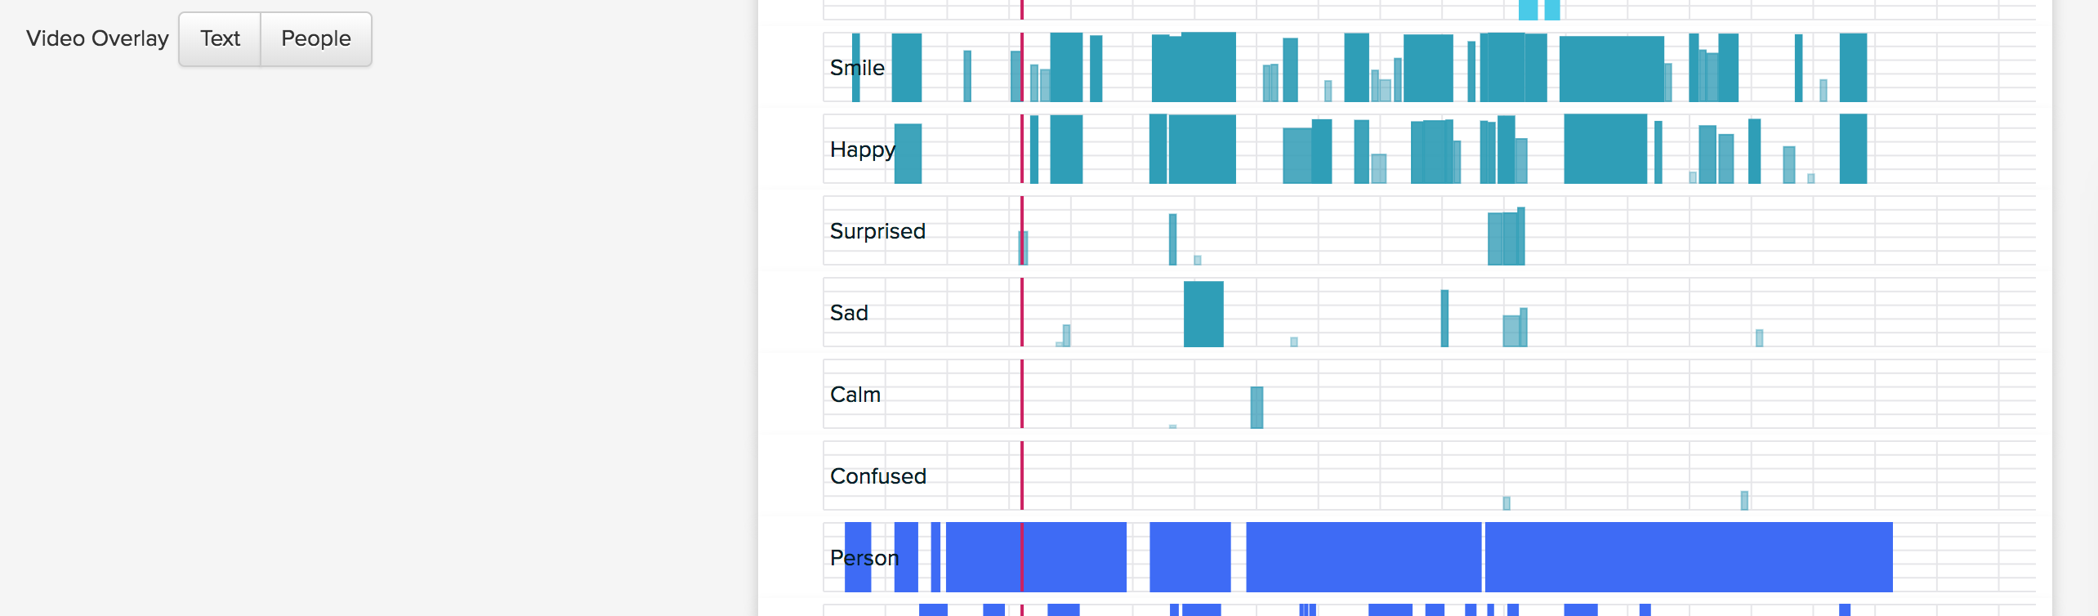
Video Analytics – new market category via VidMob
http://acs-dev.vidmob.com/demo

Slide 65
Best Practices

Slide 66
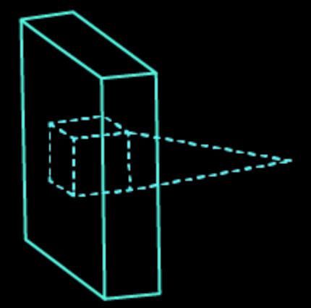
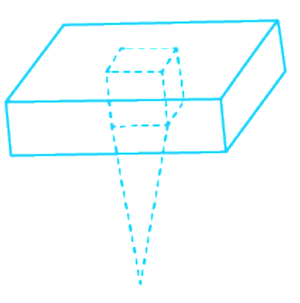
Best practices: Interfacing with Amazon Rekognition
Max image size
Amazon S3 : 15 MB
API calls: 5 MB (base64 encoded)
Image format
PNG or JPEG
Image resolution
Min 80 px, 1024 (x or y) px recommended
Size of face should occupy ~5%+ of image for detection
Collections are for faces! (not cats, cartoons, …)
For AWS CLI, upload images to Amazon S3
AWS CLI cannot pass image bytes
…

Slide 67
Best practices: Interfacing with Amazon Rekognition
Max number of faces in a single face collection is 1 million
Latency still under a second!
Max matching faces the search API returns = 4096
Use Delete* with caution
Use IAM to manage permissions
Use Amazon CloudWatch to observe/alert on Amazon Rekognition Metrics
Know the Amazon Rekognition API and save some $$$
RecognizeCelebrities returns face information from image (max 15), no need to call DetectFaces if you are just looking for presence of faces
…

Slide 68
Best practices: Interfacing with Amazon Rekognition
IndexFaces with one image….
Discard facs based on pose/quality…
False Positives:
False Negatives:
…

Slide 69











Interfacing with Amazon Rekognition
Build, test, and deploy for Amazon Rekognition using SDKs & API calls
Android
iOS
Java
JavaScript
.NET
Node.js
PHP
Python
Ruby
Xamarin
AWS CLI
or use the AWS CLI
aws rekognition detect-labels –image \ “S3Object={Bucket=mybucket,Name=image.jpg}” | \
grep -E ‘(Vehicle|Automobile|Car)’ | mail -s “Alert! Car on Property!” me@site.com
or use the rich console
https://console.aws.amazon.com/rekognition/home

Slide 70
Roadmap

Slide 71
References
Amazon Rekognition
Amazon Rekognition on AWS AI blog
Media Analysis Solution
Rekognition-Lambda-SQS
Custom Celebrities
Serverless Image Recognition processing backend
Policing user content
API Reference
Actions
Data Types

